Slide 1


Slide 2
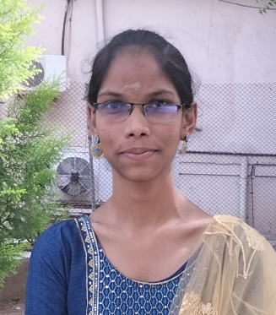
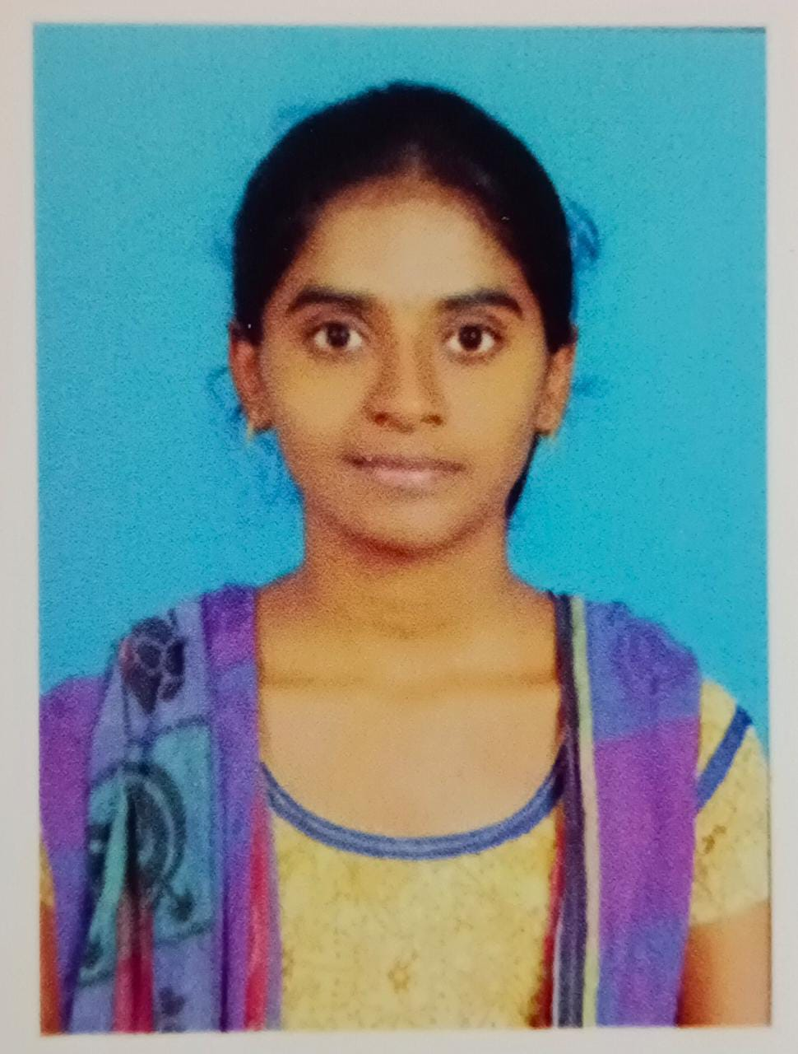
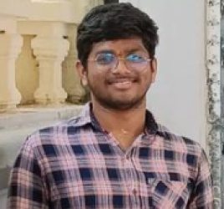
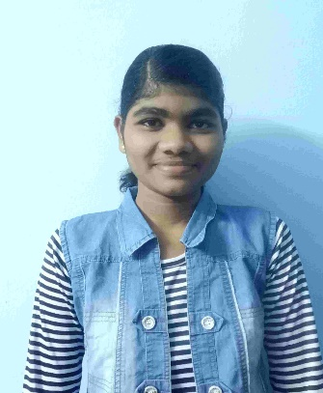
Team details
TEAM NAME: PHEONIX
Mayaluri Anusha
VIT-AP UNIVERSITY
COMPUTER SCIENCE & ENGINEERING
Graduation year: 2025
Ireddi Rakshitha
VIT-AP UNIVERSITY
COMPUTER SCIENCE & ENGINEERING
Graduation year: 2025
Chintha Sai Ganesh
VIT-AP UNIVERSITY
COMPUTER SCIENCE & ENGINEERING
Graduation year: 2025
Thokala Vasisri
VIT-AP UNIVERSITY
COMPUTER SCIENCE & ENGINEERING
Graduation year: 2025
*VIT-AP : Vellore Institute of Technology, Andhra Pradesh

Slide 3
Problem statement
Inconvenience: Traditional grocery shopping is time-consuming and disrupts daily routines.
Limited Social Interaction: Online shopping lacks the social bonding of shopping with friends and family.
Product Uncertainty: Customers miss the tactile experience of physically examining products.
Trust and Transparency: Ensuring product authenticity and supply chain integrity is challenging.
Personalization: Shopping recommendations often lack personalization.
Accessibility: Physical stores may not be accessible to everyone.
Our solution: The Virtual Shopping Mall - Combining convenience, social interaction, product authenticity, and personalization in a 3D virtual environment.

Slide 4
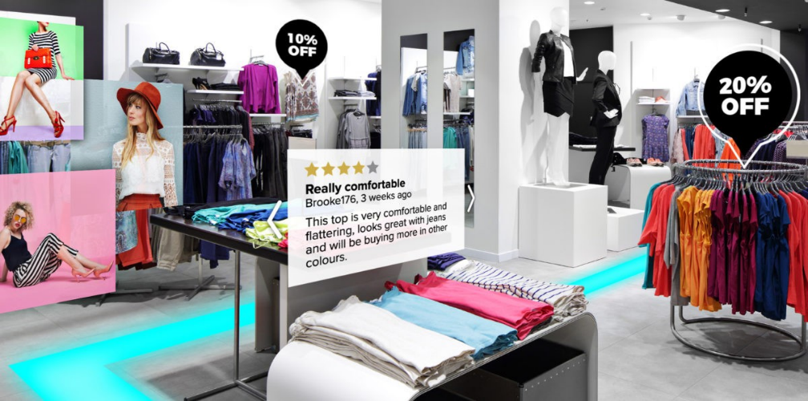

Our big Idea
🌟 Transforming Shopping for a New Era 🌟
Our idea is to introduce virtual shopping malls🛒🛒
Key Features:
Immersive Shopping: Customers can explore virtual aisles just like in physical stores, enhancing the shopping experience.
Virtual Social Shopping: Shop with friends, family, or relatives no matter where they are by creating virtual avatars.
Virtual Try-Before-Buy: Try products virtually before purchasing, ensuring satisfaction.
Benefits:
Enhanced Customer Engagement
Increased Sales and Customer Retention
Convenient Shopping Anytime, Anywhere

Slide 5
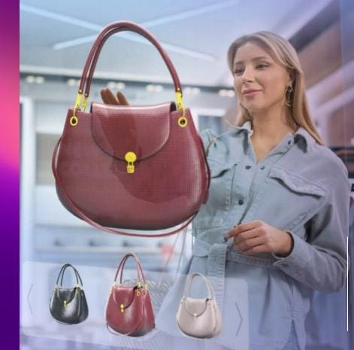
How does our innovation accelerate change with the power of Technology?
VR & AR: Immersive shopping & product try-ons.
AI: Personalized recommendations & realistic avatars.
Blockchain: Secure transactions & supply chain transparency.
Cloud: Scalable & accessible platform.
3D Modelling: Realistic virtual stores.
Secure Payments: Protect financial data.
Network: Low-latency for real-time interactions.
UI/UX Design: Intuitive shopping interface.
Data Analytics: Tailored experiences.
Cybersecurity: Protect customer data.
IoT: Real-time product info.
These technologies together redefine grocery shopping, enhancing customer engagement and boosting sales.

Slide 6
How is our solution different/unique from other solutions in market?
Our solution stands out in the market for several unique features:
Immersive Social Shopping: Shop with friends and family, creating virtual avatars for shared experiences.
Virtual Try-Before-Buy: Bridge the online-physical gap with virtual product trials, reducing returns.
Blockchain Trust: Ensure secure and transparent transactions, fostering trust in product authenticity and supply chain integrity.
Personalized AI Assistance: Tailored product recommendations and store layouts for a unique shopping journey.
Realistic 3D Shopping: High-quality 3D modeling for lifelike, physical store-like experiences.
Cross-Platform Access: Cloud-based, accessible from any device for ultimate convenience.
In summary, our Virtual Shopping Mall redefines grocery shopping into an immersive, social, and trustworthy experience, setting us apart from traditional online platforms.
Do we have a working model/prototype: No
Can we show working prototype during finale. Yes

Slide 7
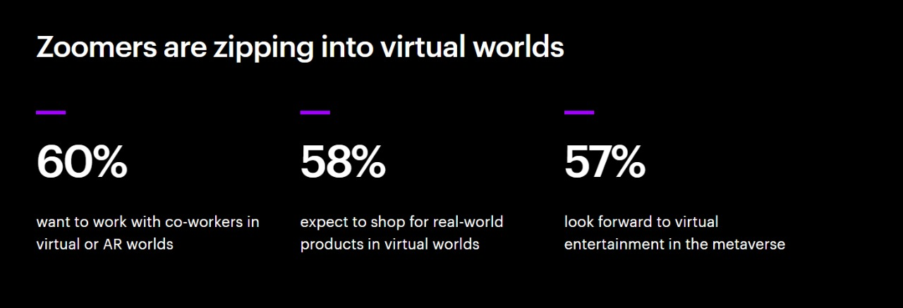
Any testimonials received?
Market Buzz & Recognition:
"Recognized as a potential game-changer by industry experts."
"Highlighted as 'Future of Retail' in industry publications."
"Featured at industry conferences for innovation.“
User Anticipation:
"Strong interest from potential users."
"Excitement building in online discussions."
"Focus group feedback indicates high interest.“
Market Validation:
"Consumer preference shifting towards immersive shopping."
"Survey data supports demand for social interaction and personalization."
"Aligns with evolving e-commerce landscape."

Slide 8


Thank you!

